Slide 1
Mental Health and Youth Sports Participation
Lucas Alessi, Robel Desta, Brian Larson, Matt Nichter, Slater Podgorny, Karen Walker

Slide 2
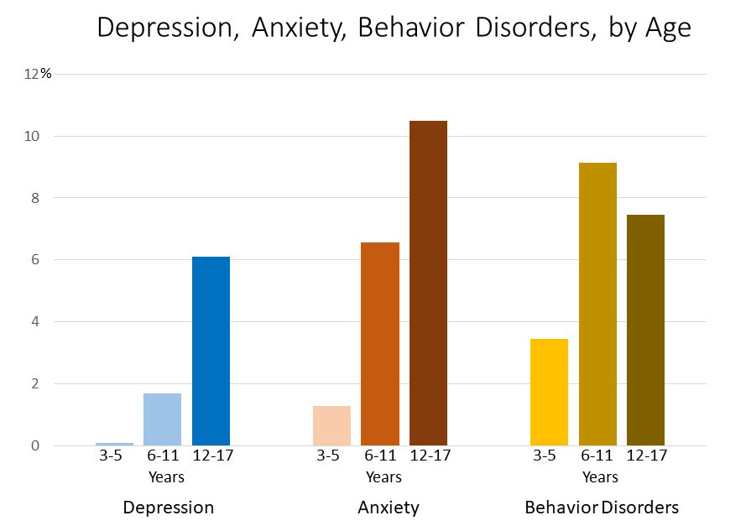
Our Problem
Mental health is being negatively impacted by decrease in youth physical activity participation
Suicide the leading cause of death for people within the age group of 10-24 year olds
Not being dealt with effectively in Colorado
Physical Activity is a effectual method in combating youth mental health issues with very impressive results
Notes:
#3 Bulletpoint
The proportion of Colorado students seriously considering suicide is similar to the national average —17.4 percent in Colorado compared with 17.7 percent nationally. However, Colorado’s rate increased from 14.5 percent in 2013 while the national average only increased slightly from 17.0 percent.

Slide 3
Specific Issue
Colorado generally regarded as a healthy state
Pockets of communities in Colorado that never get to mountains
Urban communities
Lower Income communities
Harder for kids in these communities to practice consistent physical activity
We believe that mental health in Colorado communities is being negatively impacted by a decline in physical activity in the youth and adolescent population.

Slide 4
Related to our Course
The Community Leadership Handbook, author James Krile discusses:
Importance of framing ideas
Building social capital
Mobilizing resources in order to create community change

Slide 5
Does this really exist?
Steady increase in adolescents with mental health issues since 2005 (American Psychology Association, 2019)
What may have caused it?
Social media use
Decrease in sleep
Exercise reduces anxiety and depression (Sharma, Madaan, & Petty, 2006)
Increased blood flow
Improves self esteem

Slide 6
Who have we contacted?
Potential Partners
Boys and Girls Club
Chad Pennick- Children’s Hospital
Lauren Pieterek- Girls on the Run
Frank DeAngelis - Former Columbine Principal
All Stakeholders We Met With
Kim Poast- Colorado Department of Higher Education
Dallas Davis- Rockies
Molly Cohn- JCC Denver
Kate Labore- The Road
Susan Anderson- Wheat Ridge Parks & Recreation

Slide 7
What do people think about this problem?
What are People Saying About Youth Sports Participation?
Parents
Stakeholders
What is the Cause of Our Issue?
Participation
Limited Variety of Sports
Current Conflicts Revolving Around Our Problem:
Social Media
Notes:
Parents - Limited sports at the elementary to middle school level … even in high school
Stakeholders - Mr.DeAngelis talking about how it builds character and life long skills such as leadership and communication that we carry throughout our lives
Participation Number - Low due to kids wanting to stay inside

Slide 8
Our ideas
Develop a curriculum
Work with an organization and test it.
Implement it into schools that need it.

Slide 9
Sources
Mental health issues increased significantly in young adults over last decade. (2019, March 15). American Psychology Association. Retrieved from https://www.sciencedaily.com/releases/2019/03/190315110908.htm.
Sharma, A., Madaan, V., & Petty, F. D. (2006). Exercise for mental health. Retrieved from https://www.ncbi.nlm.nih.gov/pmc/articles/PMC1470658/.
Suicide Statistics. (2019, April 16). Retrieved from https://afsp.org/about-suicide/suicide-statistics/.
Krile, J. F., Curphy, G. J., & Lund, D. R. (2006). The community leadership handbook: Framing ideas, building relationships, and mobilizing resources. Fieldstone Alliance.

